Slide 1
LaPave Walkthrough
Concrete

Slide 2
Basics
File is locked down to prevent overwriting of formulas
Light blue cells are for user inputs, some may be drop downs
Simulates a database
Can handle multiple Projects/JMFs

Slide 3
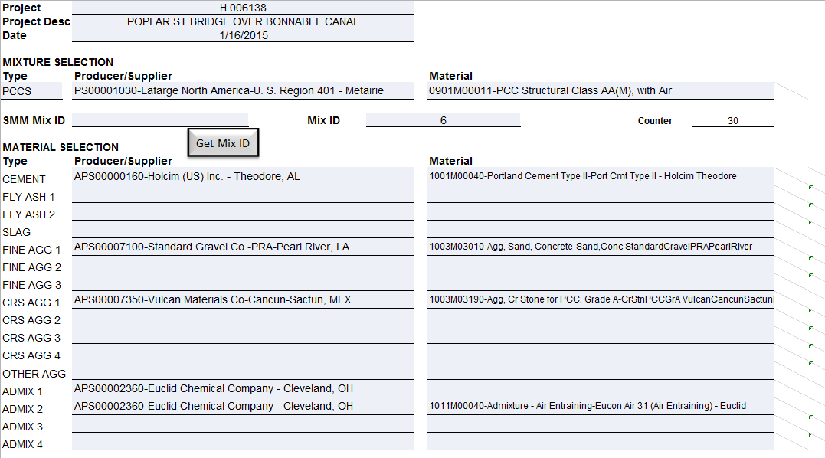
Inputs
Most fields are dropdowns populated with Material Codes from SMM
[Get Mix ID] – Generates a unique mix id to be entered into SMM

Slide 4
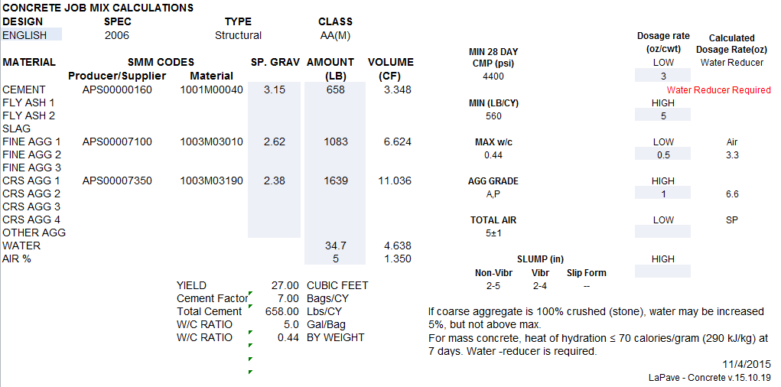
Checks
Mix design computations check
Working on metric version
Flags if items do not match spec of selected mix type

Slide 5
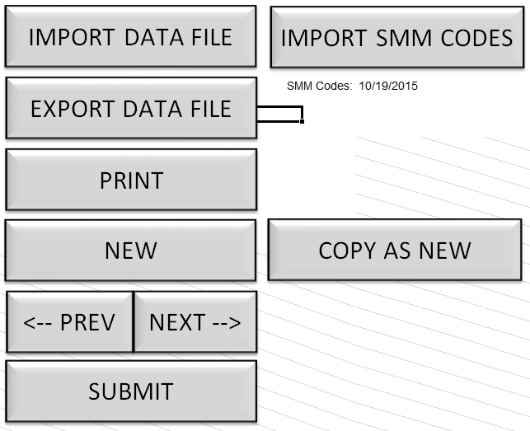
Checks
[New] – creates blank sheet
[<-] and [->] – scrolls through mix designs
[Submit] – saves mix design
[Copy] – creates a copy of selected mix design
[Export] – creates a file with data only (for email)
[Import] – imports data only file
[Import SMM Codes] – still working on this, will update the smm codes in the drop downs

